Slide 1
Key Requests
Submit, Manage, Approve
Created: 10/29/25

Slide 2
Agenda
ACCESSING THE KEY REQUEST FORM
KEY REQUEST TYPES
USER TYPES
REQUEST INFORMATION
PAYMENT OPTIONS & PICKUP DETAILS
REVIEW & SUBMIT
APPROVER SELECTION
VIEW REQUESTS
APPROVAL PROCESS
NOTIFICATIONS & CANCELLATIONS
REQUEST FULFILLMENT
Notes:
Please note: Agenda items have been broken out into individual items in accordance with ADA digital accessibility best practices.

Slide 3
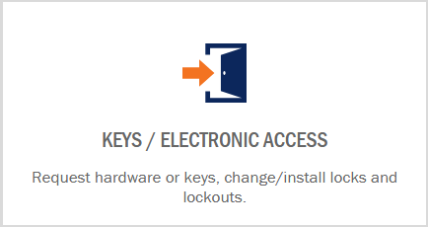
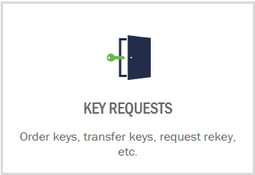
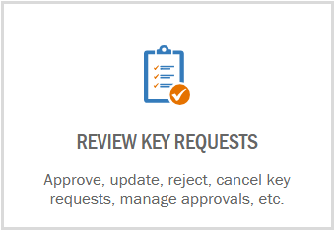
Accessing the Key Request Form
The Key Request Form is accessible via the Customer Portal within the Keys/Electronic Access tile named Key Requests.
Requests can be reviewed within the tile named Review Requests.
The Customer Portal URL is https://customerportal.fm.virginia.edu
Notes:
The form to request physical keys can be found in the Customer Portal.
The Customer Portal can be accessed from fm.virginia.edu or directly from customerportal.fm.virginia.edu.
Once on the Customer Portal, which requires NetBadge authentication, click the Keys/Access tile.
The Access to Space tile takes the user to the key request form.
The Review Requests tile takes the user to a dashboard where they can view requests they have submitted and/or have an action pending.
In addition to the request form for physical keys, the Keys/Access page offers information about Lock-Outs and Lost Keys for students and staff.
Students housed by UVA, that are not an employee of UVA, in need of physical keys should contact Housing and Residential Life using the information and links on the Residential Lock-Out/Lost Key tile instead of using the key request form.
All employees of UVA, with a computing ID, who use or need physical keys to access areas of the university to fulfill their job duties must use the key request form.
Employees that do not have a computing ID who use or need physical keys must have an employee with a computing ID submit a key request on their behalf, known as a sponsor. The sponsor must remain responsible for the keys given to an employee without a computing ID.

Slide 4
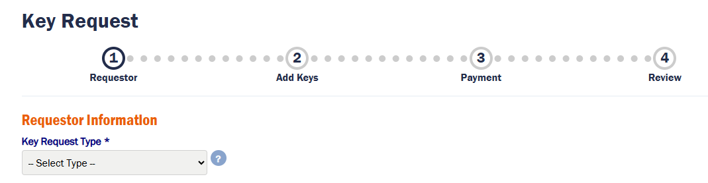
Key Request Types
There are 5 types of key requests. A request type must be identified for each request.
New – a key that is not being replaced
Temporary – a key that is needed for a defined period
Transfer – update the responsible person for one or more keys
Rekey - change the key for one or more doors
Replacement - a key that is being replaced due to damaged, lost or stolen key
Notes:
The first step in creating a key request is defining the type of request that you are going to make.
To help you decide, think of why you are making the request.
Is it to get a key for a new employee or space? Choose “New”.
Maybe you need a new key, but only for a few months. Choose “Temporary”.
Do you need to give a key that you have to someone else? Choose “Transfer”.
Are you responsible for requesting doors to be rekeyed? Choose “Rekey”.
Maybe you have a damaged key, or someone has lost or had a key stolen. Choose “Replacement”.
A rekey could also be triggered by a lost or stolen key depending on what the key was for. In this case you would choose “Rekey” and include the keys needed in that request.

Slide 5
User
Types
There are 3 types of user that can be identified in a key request.
Requester – the person who is submitting the request; the person designated as the responsible person if no responsible person is declared
Responsible Person – the person who will be responsible for and/or retain the keys created due to the request
Pick up Person – the person who has been declared to pickup the created keys and deliver them to the requester or responsible person
For Transfer requests, only the requester is needed.
Notes:
Once you have chosen a request type, you can identify who will be involved in the key request.
The “Requester” is the person submitting the request and will be auto-populated as the user authenticated on the Customer Portal.
If you are creating a key request for someone that will be responsible for the keys, check the box and enter the computing ID of the responsible person.
If you need someone other than the requester or responsible person to pick up the keys, check the box and enter the computing ID of the pickup person.
All these users must have computing IDs as keys must be received by a university employee.
They key(s) can then be given to others for use, under the supervision of the responsible person.
Keys can be transferred to non-UVA employees using the “Transfer” request type; however, a UVA employee must still be designated as a responsible person.

Slide 6
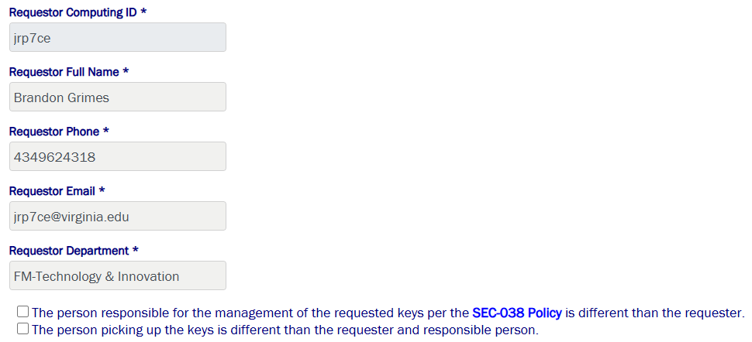
User Information
Check the box for the Responsible and/or Pickup Person to add these users to requests other than Transfers.
Notes:
Once you have chosen a request type, you can identify who will be involved in the key request.
The “Requester” is the person submitting the request and will be auto-populated as the user authenticated on the Customer Portal.
If you are creating a key request for someone that will be responsible for the keys, check the box and enter the computing ID of the responsible person.
If you need someone other than the requester or responsible person to pick up the keys, check the box and enter the computing ID of the pickup person.
All these users must have computing IDs as keys must be received by a university employee.
They key(s) can then be given to others for use, under the supervision of the responsible person.
Keys can be transferred to non-UVA employees using the “Transfer” request type; however, a UVA employee must still be designated as a responsible person.

Slide 7
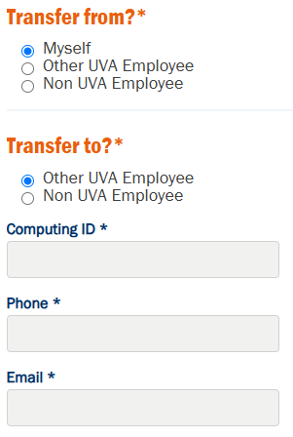
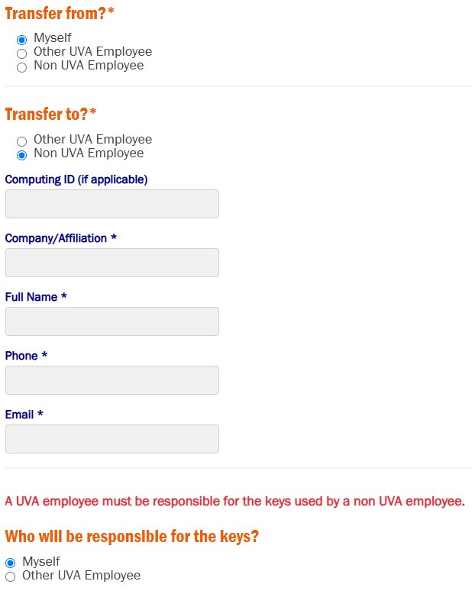
Transfer Users
For Transfers, the people who the key(s) is being transferred to and from will be required and can be UVA or non-UVA employees.
Myself – the requester
Other UVA Employee – a UVA employee with a computing ID
Non-UVA Employee – a person without a computing ID, who must be sponsored by a UVA employee
Notes:
Once you have chosen a request type, you can identify who will be involved in the key request.
The “Requester” is the person submitting the request and will be auto-populated as the user authenticated on the Customer Portal.
If you are creating a key request for someone that will be responsible for the keys, check the box and enter the computing ID of the responsible person.
If you need someone other than the requester or responsible person to pick up the keys, check the box and enter the computing ID of the pickup person.
All these users must have computing IDs as keys must be received by a university employee.
They key(s) can then be given to others for use, under the supervision of the responsible person.
Keys can be transferred to non-UVA employees using the “Transfer” request type; however, a UVA employee must still be designated as a responsible person.

Slide 8
Key Request
Information
For each request type, there is minimum required information defined, as well as supporting fields to expand on your request.
Required on all request types, except Transfers
  Property – searchable by number or name
  Type of Key – interior or exterior
  Quantity – represents total number of keys being requested
Required on Transfer Requests only
  Key Number(s) – the engraved identifier on the key, either alpha-numeric or six-digits
Required on all request types
  Justification – why is the key(s) being requested?
Conditionally Required on all request types, except Transfers
  Explanation – required if no rooms and/or key numbers are provided
Required for Temporary Requests only
  Return Date – when will the key no longer be needed?
Should a key be reported lost or stolen via a Replacement or Rekey request, you may have to report it to the UPD or local agency and provide a police report number.
Notes:
You have decided on the type of request and who is included, now you will need to provide information that will allow the Lock Shop to determine the keys that are needed.
Unlike the Transfer request that just asks for the key numbers and who you are giving them to; the other request types require more information.
First, you will need to choose the property or building that you need keys for. Only one property can be chosen per request.
This is searchable by number or name.
Second, is this key for a door on the exterior of the building or a door within the building?
If you choose Interior, a room selection box will appear.
There are cases where a room will not appear for selection. If that occurs, enter the number, name and/or description of the room in the text box at the bottom of the page.
Another way to identify the key you need is to provide the number of a key.
The most likely scenario is that another employee tells you to order a key for a door, a key which they have. You can enter the number on the key they have and that can be referenced by the Lock Shop to make your key.
You must have a room selected or a key number entered, else you will have to enter details in the text box at the bottom of the page to complete your request.
Next is the Justification. This is required and provides context for why the key is being ordered.
If the reason you have is not listed, choose “Other” and type it in.
Lastly, the text box at the bottom of the page, that we mentioned a few times, should be used to further detail your request.
Additional information here could provide valuable information that could keep your request moving and reduce questions from the Lock Shop and approvers.

Slide 9
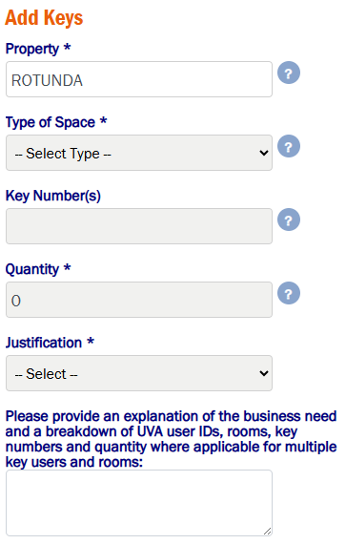
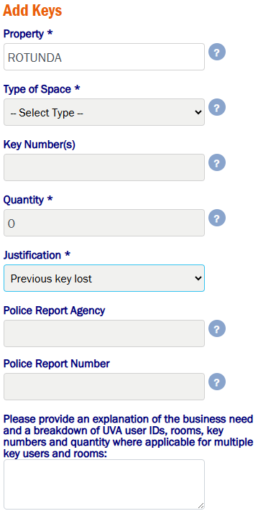
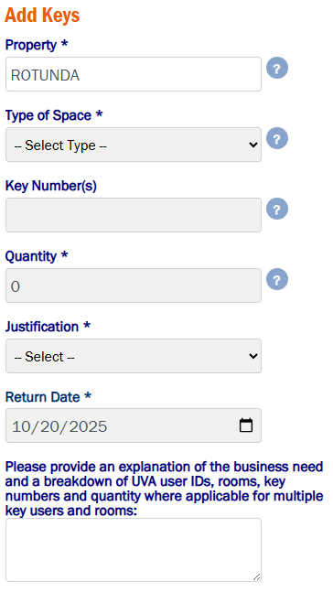
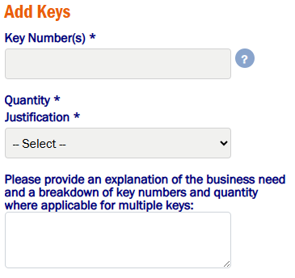
Key Request Information
The fields on the form may differ based on the request type and Justification chosen.
Notes:
You have decided on the type of request and who is included, now you will need to provide information that will allow the Lock Shop to determine the keys that are needed.
Unlike the Transfer request that just asks for the key numbers and who you are giving them to; the other request types require more information.
First, you will need to choose the property or building that you need keys for. Only one property can be chosen per request.
This is searchable by number or name.
Second, is this key for a door on the exterior of the building or a door within the building?
If you choose Interior, a room selection box will appear.
There are cases where a room will not appear for selection. If that occurs, enter the number, name and/or description of the room in the text box at the bottom of the page.
Another way to identify the key you need is to provide the number of a key.
The most likely scenario is that another employee tells you to order a key for a door, a key which they have. You can enter the number on the key they have and that can be referenced by the Lock Shop to make your key.
You must have a room selected or a key number entered, else you will have to enter details in the text box at the bottom of the page to complete your request.
Next is the Justification. This is required and provides context for why the key is being ordered.
If the reason you have is not listed, choose “Other” and type it in.
Lastly, the text box at the bottom of the page, that we mentioned a few times, should be used to further detail your request.
Additional information here could provide valuable information that could keep your request moving and reduce questions from the Lock Shop and approvers.

Slide 10
Payment Options
&
Pickup Details
There are 3 payment options with the key request form. Transfer requests do not require payment.
Worktag – will allow for a WD# and/or Worktag to be entered
FM Construction Project – requires a PJ and WO number
External Customer – searchable by CST# or entity name
Should a split payment be required, please include a note in the request and/or contact the Customer Support Center after creating your request.
The Payment page is also where you will identify where and when you would like the keys to be available. These fields are required.
Notes:
Payment is required on all requests other than Transfers.
The payment information entered will be used for all created keys and work related to rekeys.
The Worktag option allows the requester to add a WD number which will auto-populate the worktag or manually enter the worktag.
The FM Construction Project option requires a PJ and WO number, where both fields allow for searching and auto-populate.
External Customer is to be used for entities that are registered with Facilities Management Finance and allows for searching and auto-populate.
If you have an external customer that is not registered with FM Finance, please get them registered, before or soon after the request is submitted, so that the keys and/or work can be billed.
Should you need to split payment across sources, please contact the Customer Support Center after creating your request.
At this time, you will be required to identify where you want to pick up the keys and your desired pickup date.
Please note that the desired pickup date is not a guarantee and depends on how quickly the request is approved. Your patience and involvement working with the approvers to expedite the request is appreciated.

Slide 11
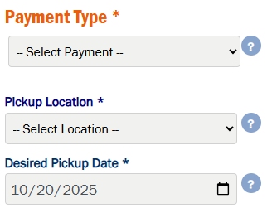
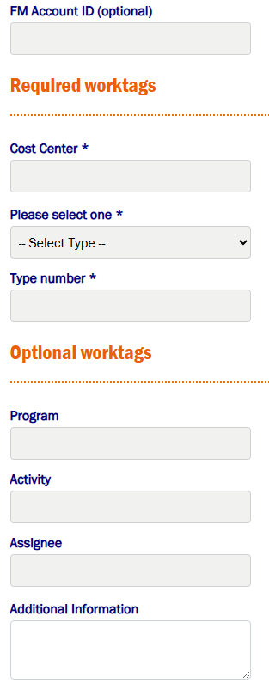
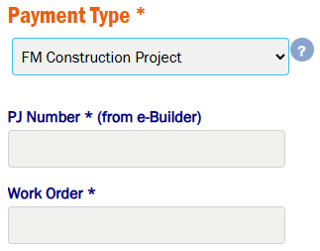
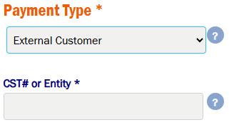
Payment Information
All fields are required, and payment information is searchable and will auto-populate where applicable.
Notes:
Payment is required on all requests other than Transfers.
The payment information entered will be used for all created keys and work related to rekeys.
The Worktag option allows the requester to add a WD number which will auto-populate the worktag or manually enter the worktag.
The FM Construction Project option requires a PJ and WO number, where both fields allow for searching and auto-populate.
External Customer is to be used for entities that are registered with Facilities Management Finance and allows for searching and auto-populate.
If you have an external customer that is not registered with FM Finance, please get them registered, before or soon after the request is submitted, so that the keys and/or work can be billed.
Should you need to split payment across sources, please contact the Customer Support Center after creating your request.
At this time, you will be required to identify where you want to pick up the keys and your desired pickup date.
Please note that the desired pickup date is not a guarantee and depends on how quickly the request is approved. Your patience and involvement working with the approvers to expedite the request is appreciated.

Slide 12
Review & Submit
A review screen is provided to allow a final look at the request prior to submitting. Minimal changes can be made on this page.
The following fields can be modified on the Review page
  Key Numbers
  Quantity
  Requestor Notes
  Watcher
  Approvers
    See the next slide on approver selection prior to submitting
Payment can be edited or changed by clicking Back. Responsible and Pickup Person can be changed by clicking Back from the Payment page. All other changes will require you to restart your request.
Notes:
The Order Detail page allows you to review your request prior to submitting.
There are a few fields that can be edited here: Key Numbers, Quantity and Requestor Notes.
Approvers may allow edits, but we will cover that in a bit.
Should you need to change details from the Payment or Requestor pages, please use the Back button.
Other changes will require you to restart your request.

Slide 13
Approver Selection
Approvers for key requests are selected based on the responsible person’s supervisor and the supervisor’s supervisor and follow the rules below.
Supervisor approval is required for all key requests
Department approval (supervisor’s supervisor) is required for key requests that include either/both of the following…
  Master Key, as defined by the policy
  Electronic Access Control Override Key, as defined by the policy
Alternate approvers can be configured for supervisor or departmental approvers by the Customer Support Center. The request must come from the individual who requires an alternate approver via email.
Notes:
Approvers for keys requests are selected based on the responsible person’s supervisor and the supervisor’s supervisor.
Supervisor approval is required for all key requests.
Department approval (supervisor’s supervisor) is required for key requests that include either/both Master or Electronic Access Control Override Key.
These designations will be determined by the Lock Shop when your request is reviewed.
For people that have more than one supervisor and/or more than one department approver (supervisor’s supervisor), you will be able to choose the supervisor that you would need to approve the request.
Some approvers may designate alternates to approver in their place.
An alternate will appear when applicable and note who they are an alternate for.
Work has been done to identify alternate approvers across all schools ahead of the release of this new request form. However, if someone needs to have an alternate configured, please contact the Customer Support Center. The request must come from the individual who requires an alternate approver via email.

Slide 14
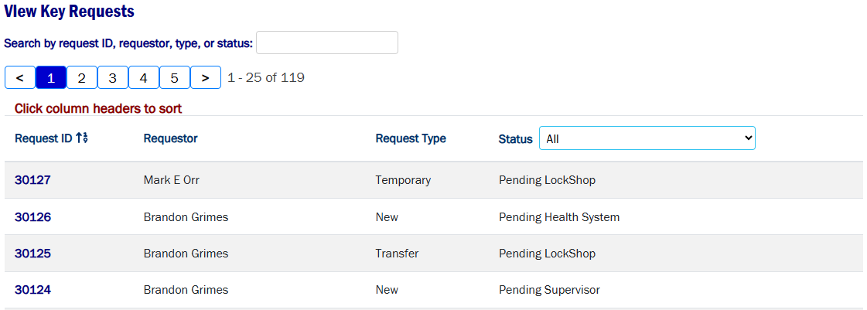
View Requests
A user can view all requests that they have submitted, are a part of and have an action pending, such as approval.
The Requester, Responsible Person or Pickup Person can view, edit and cancel requests they are named on
Requests can be searched, sorted and filtered based on status
Notes:
All Requesters, Responsible Persons, and Pickup Persons can view requests that they are on.
The Lock Shop, Customer Support Center, and Approvers will also see requests in this view.
Requests can be searched, sorted and filtered based on status.
Click on a Request ID and a detail page will appear containing all the details from the requester.
The Pickup Location and Pickup Person can be updated at anytime, but please coordinate with the Customer Support Center if after the request is approved.
The Pickup Person will be set and locked to the Responsible Person if a Master or Electronic Access Control Override Key is being created.
The Requester Notes can be updated prior to the request being approved.
The Customer Support Center can update the payment information if a change is needed prior to approval.
View Status History will show who has approved the request and who is next to approve.
The request can be cancelled by the Lock Shop, Requester, Responsible Person or Pickup Person.

Slide 15
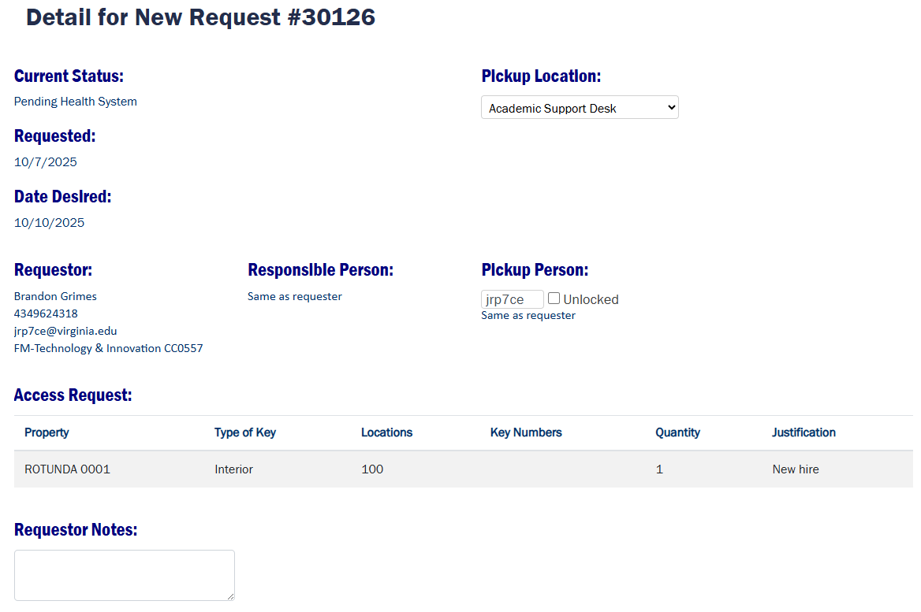
Request Detail
Requester Notes can be updated prior to approval
Pickup Location and Pickup Person can be updated at any time, but please coordinate with the Customer Support Center if after the request is approved
  Pickup Person will be set and locked to the Responsible Person if a Master or Electronic Access Control Override Key is being created
Notes:
All Requesters, Responsible Persons, and Pickup Persons can view requests that they are on.
The Lock Shop, Customer Support Center, and Approvers will also see requests in this view.
Requests can be searched, sorted and filtered based on status.
Click on a Request ID and a detail page will appear containing all the details from the requester.
The Pickup Location and Pickup Person can be updated at anytime, but please coordinate with the Customer Support Center if after the request is approved.
The Pickup Person will be set and locked to the Responsible Person if a Master or Electronic Access Control Override Key is being created.
The Requester Notes can be updated prior to the request being approved.
The Customer Support Center can update the payment information if a change is needed prior to approval.
View Status History will show who has approved the request and who is next to approve.
The request can be cancelled by the Lock Shop, Requester, Responsible Person or Pickup Person.

Slide 16
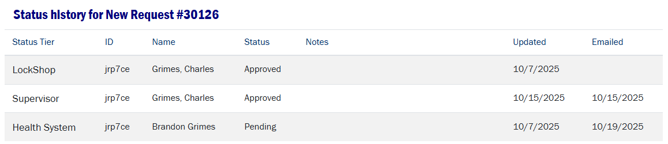
Request Status History
Status History should be used to follow up with approvers to expedite
Notes:
All Requesters, Responsible Persons, and Pickup Persons can view requests that they are on.
The Lock Shop, Customer Support Center, and Approvers will also see requests in this view.
Requests can be searched, sorted and filtered based on status.
Click on a Request ID and a detail page will appear containing all the details from the requester.
The Pickup Location and Pickup Person can be updated at anytime, but please coordinate with the Customer Support Center if after the request is approved.
The Pickup Person will be set and locked to the Responsible Person if a Master or Electronic Access Control Override Key is being created.
The Requester Notes can be updated prior to the request being approved.
The Customer Support Center can update the payment information if a change is needed prior to approval.
View Status History will show who has approved the request and who is next to approve.
The request can be cancelled by the Lock Shop, Requester, Responsible Person or Pickup Person.

Slide 17
Approval Process
The number of approval for a key request is dependent on the keys that will be created. See below for the process and conditions that affect it.
The Lock Shop will review all requests when they are submitted
The Supervisor will be required to approve all key requests
The Department (supervisor’s supervisor) is required for key requests that include either/both of the following…
  Master Key, as defined by the policy
  Electronic Access Control Override Key, as defined by the policy
The Department of Safety & Security is required for key requests that include either/both of the following…
  Master Key, as defined by the policy
  Electronic Access Control Override Key, as defined by the policy
Other approvers may be added based on the content of the request. For example, a door that provides access to a roof or mechanical room will require approval by a representative of that location.
Notes:
When a request is submitted, the Lock Shop will conduct a review to understand what keys they will need to create. If there are questions, they will reach out to the requester.
After the Lock Shop determines the key that will be created, they will enter that information into the request.
This information will be available to all users.
The Lock Shop may determine that other approvers are needed, such as the Department of Safety & Security or other representatives of a property.
For example, a door that provides access to a roof or mechanical room will require approval by a representative of that location.
The request will then be forwarded to the first approver and as each approves, it is sent to the next.
Once fully approved, the Lock Shop will complete their work and deliver the keys to the Customer Support Center.

Slide 18
Notifications &
Cancellations
All parties involved in a key request will be notified of pertinent events and actions they are responsible for.
Emails are sent for the following…
  Request Confirmation is sent to the Requester, Responsible Person and Pickup Person
  Approval Requests, including 3-day and 7-day reminders, are sent to each approver in turn
  Should the request be rejected or cancelled, an email will be sent to the Requester, Responsible Person and Pickup Person
    Requests cancel after 30 days if not approved
  When keys are ready to be picked up, Requester, Responsible Person and Pickup Person will receive and email, including 7-day and 14-day reminders
    Keys will be destroyed on day 15 with an email sent to the Requester, Responsible Person and Pickup Person and a new request will need to be submitted
Should there be a need to adjust any timeline, please contact the Customer Support Center.
Notes:
The Requester, Responsible Person and Pickup Person will be notified when their request is submitted and ready for pickup.
Other notifications will be sent should an event cause the request to be interrupted, such as a rejection or cancellation.
Requests cancel after 30 days if not approved.
Approvers receive emails when their action is needed, in addition to 2 reminder emails at 3 and 7 days.
The Requester, Responsible Person and Pickup Person will receive 7-day and 14-day reminders when their keys are ready for pickup.
Keys will be destroyed on the 15th day, if not picked up. A notification will be sent for this as well.
If you need an extension to pick up your keys, please contact the Customer Support Center.

Slide 19
Request Fulfillment
After a request has been approved, you will be notified when the keys are ready to be picked up at the Customer Support Center.
Some requests do not result in keys being picked up
  Transfers
  Rekey with no keys requested (using existing keys)
When the request does result in keys being picked up
  Rekeys with new keys can be delivered at the time of rekey work or picked up at the Customer Support Center
  All other keys will be at the Customer Support Center
Notes:
When you receive the notification that your keys are ready to be picked up, you can head over to the Customer Support Center location that you identified in your request. It will also be noted in the email that you receive.
You may receive this email after the Lock Shop complete work to rekey a space, as they can deliver your keys on site in those situations.
The Requester, Responsible Person or Pickup Person can sign and receive the keys.

Slide 20
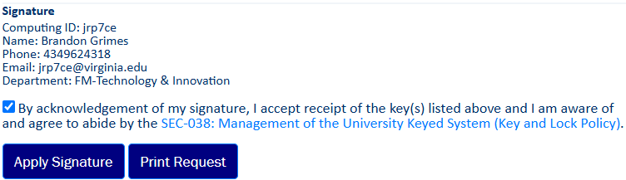
Signature
You will be required to sign for the keys in the detail page of your request
Sign before picking up or at the Customer Support Center
Signing confirms you are receiving the keys and are aware of the policy
The Requester, Responsible Person or Pickup Person can sign and receive the keys
Notes:
When you receive the notification that your keys are ready to be picked up, you can head over to the Customer Support Center location that you identified in your request. It will also be noted in the email that you receive.
You may receive this email after the Lock Shop complete work to rekey a space, as they can deliver your keys on site in those situations.
The Requester, Responsible Person or Pickup Person can sign and receive the keys.
Be sure to have your device available to sign for the keys at time of pickup, if signing at the Customer Support Center.

Slide 21
Thank you!
Please Contact the customer support center if you have any questions

