Slide 1
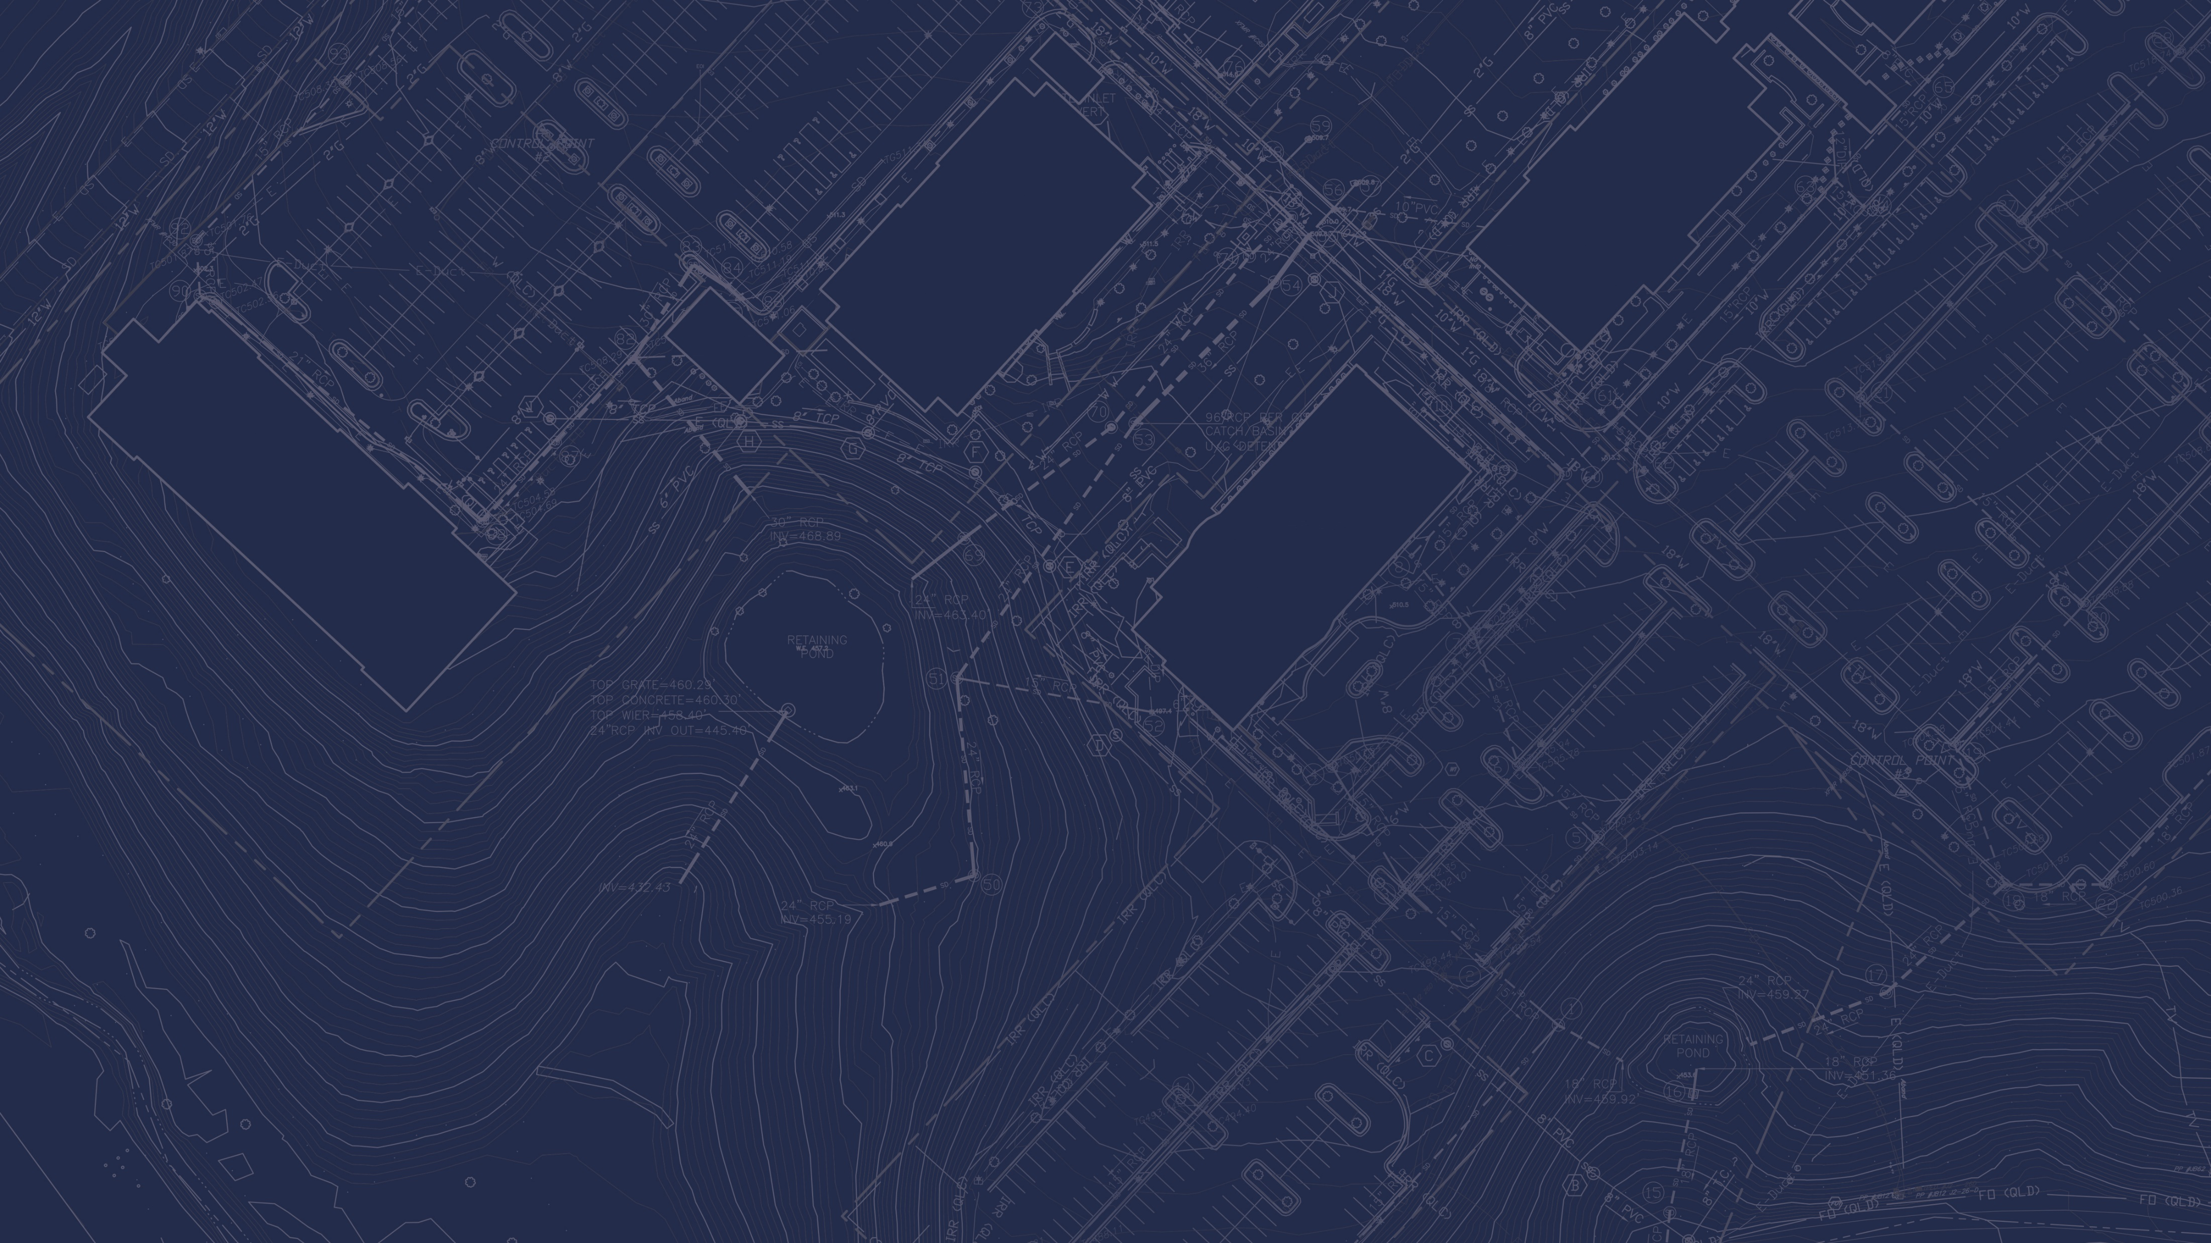
FONTAINE PARKING GARAGE
TOWN HALL
February 10, 2025

Slide 2
Agenda
Welcome, Introductions, & Project Information Taryn Spence
Enabling Work/ RCH Road Closure Breeden Construction
Traffic & Pedestrian Impacts Sam Walker
Q&A
Notes:
Project Teams
Institute of Biotechnology Mashal Afredi-Hartman
Central Energy Plant John Marshall
Roadway Infrastructure Taryn Spence
Parking Garage Taryn Spence
Encompass Renovation Rachelle Hermes

Slide 3
PROJECT INFORMATION
Taryn Spence

Slide 4
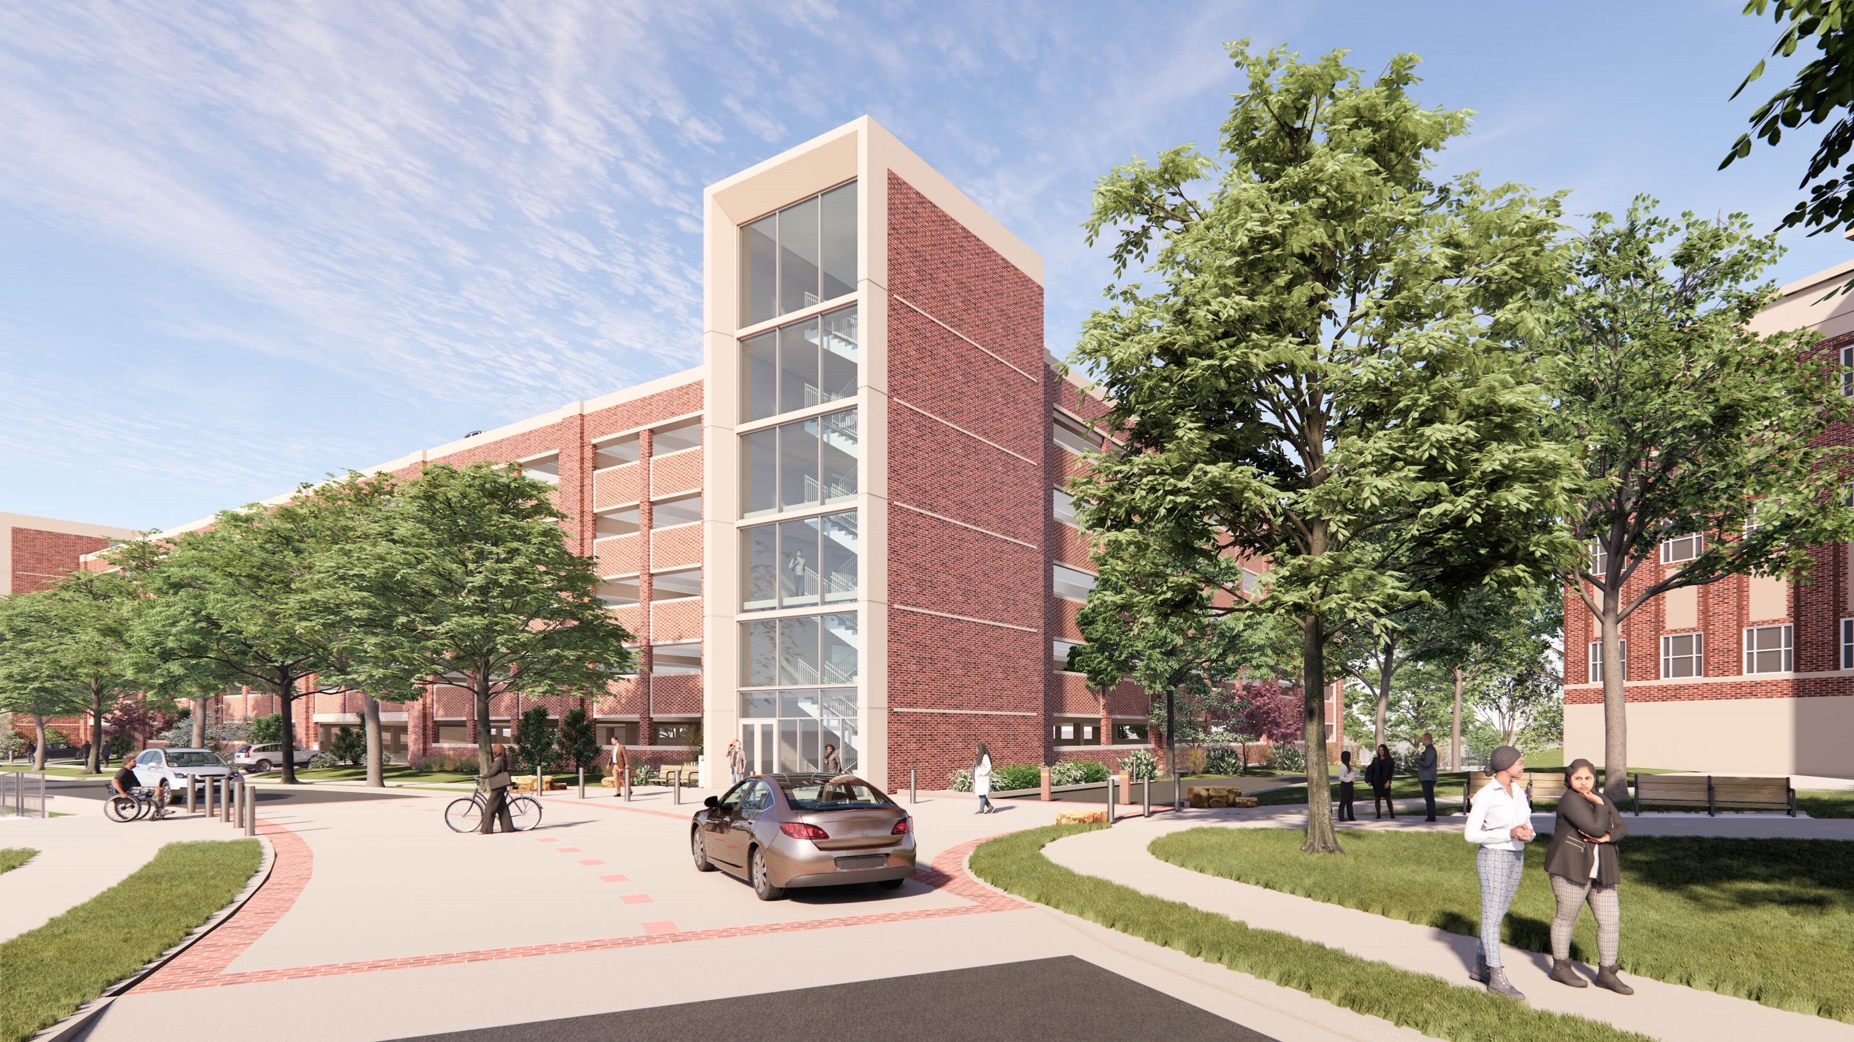
Parking Garage Project
4
Notes:
Alice Raucher

Slide 5
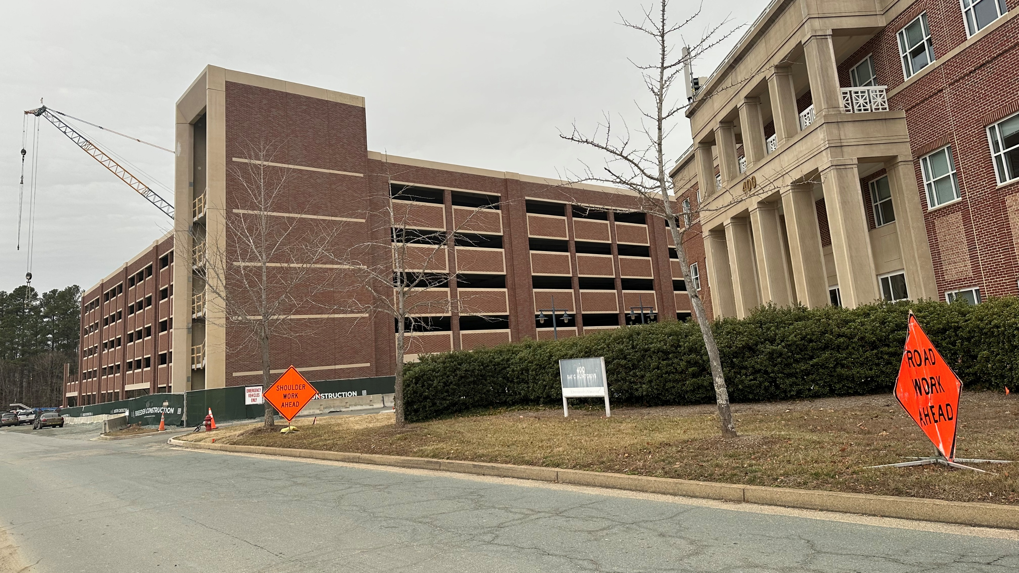
Parking Garage Construction Progress
Notes:
Alice Raucher

Slide 6
ENABLING WORK/ RAY C HUNT ROAD CLOSURE
Breeden Construction

Slide 7
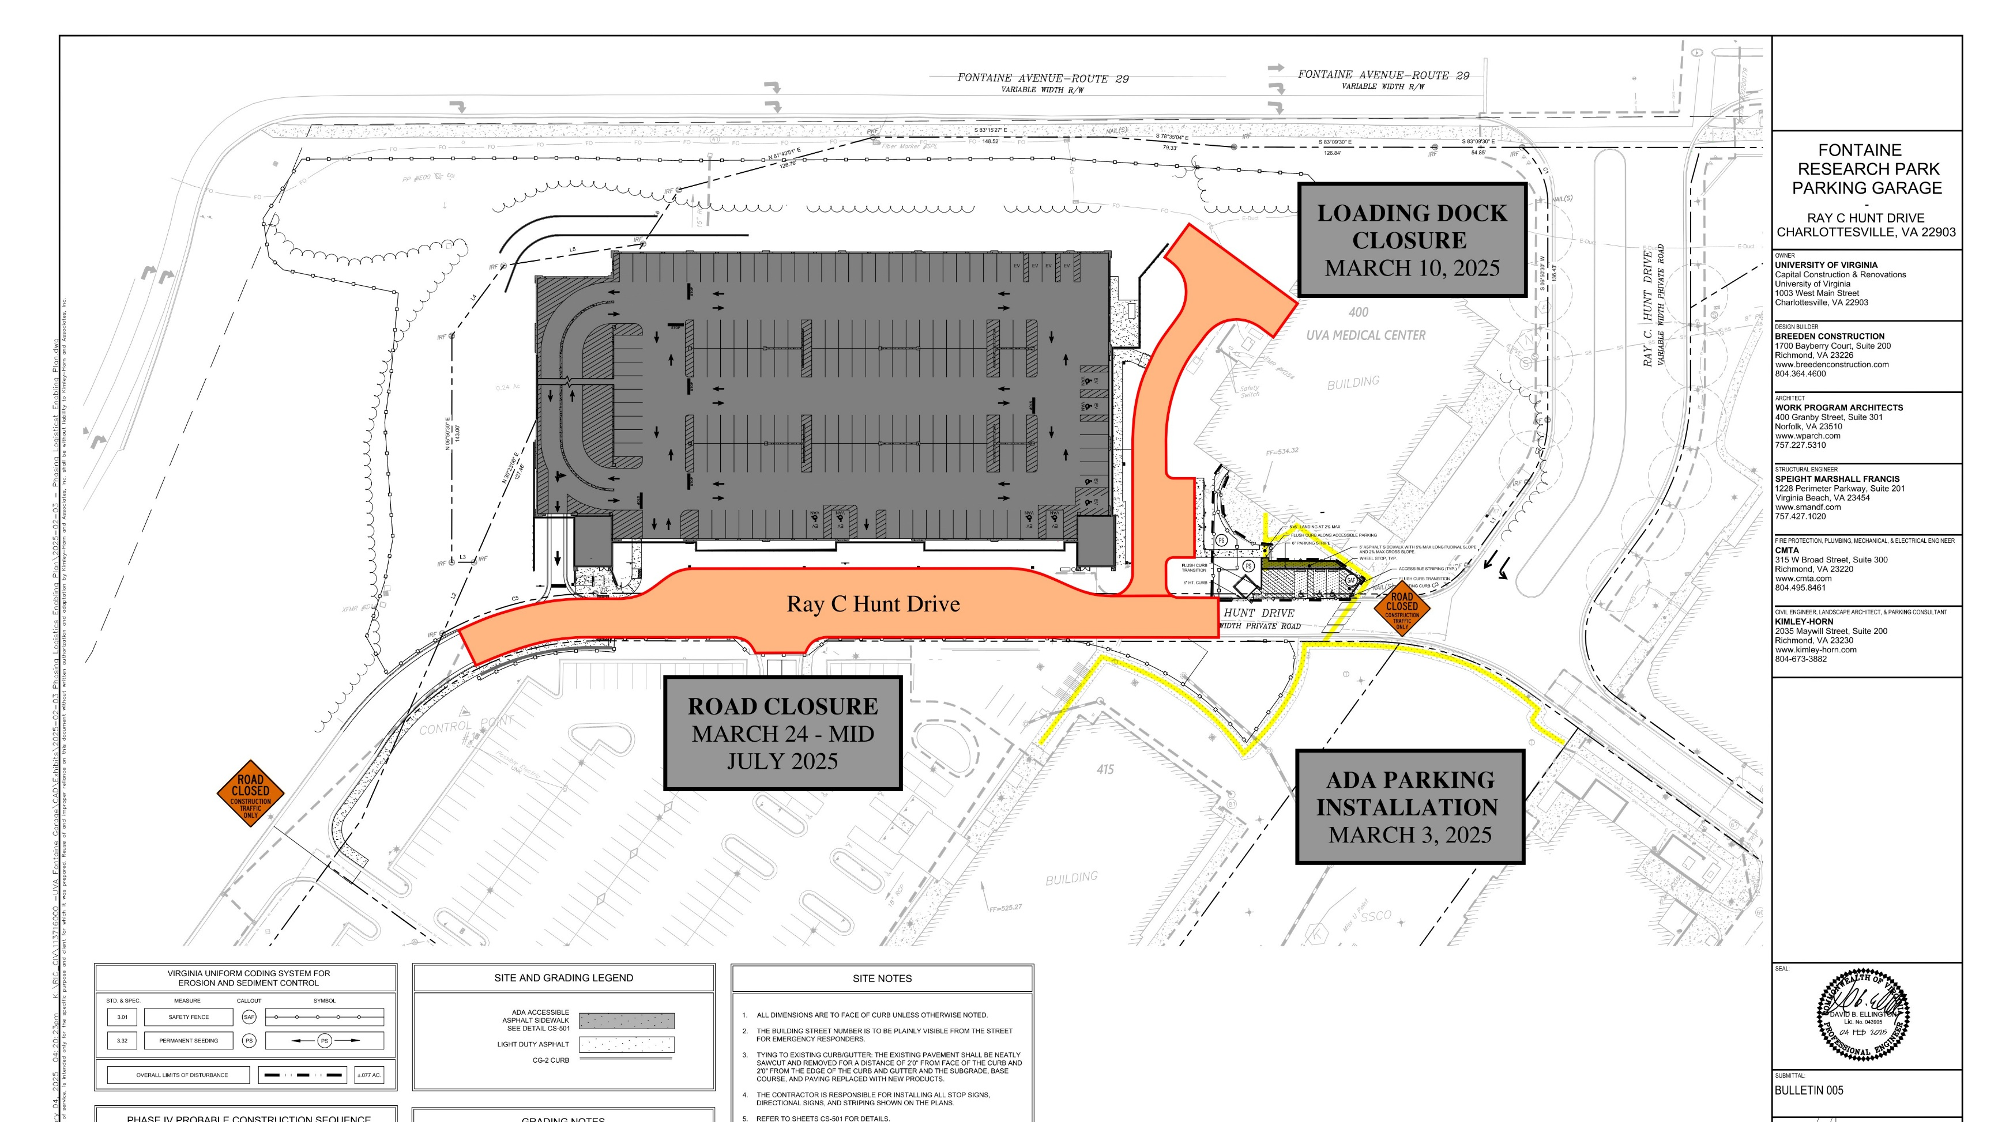

Slide 8
Enabling Work at 400 Ray C Hunt Building – March 3 – 10, 2025
Scope of work :
  New ADA parking spaces and service area installation in front of 400 RCH
Impacts:
  Intermittent lane narrowing on Ray C Hunt Drive leading to potential delays/back-ups
  Construction noise to demo existing curbing and install new asphalt area
  400 RCH loading dock will remain open during this time
Notes:
Project Teams
Institute of Biotechnology Mashal Afredi-Hartman
Central Energy Plant John Marshall
Roadway Infrastructure Taryn Spence
Parking Garage Taryn Spence
Encompass Renovation Rachelle Hermes

Slide 9
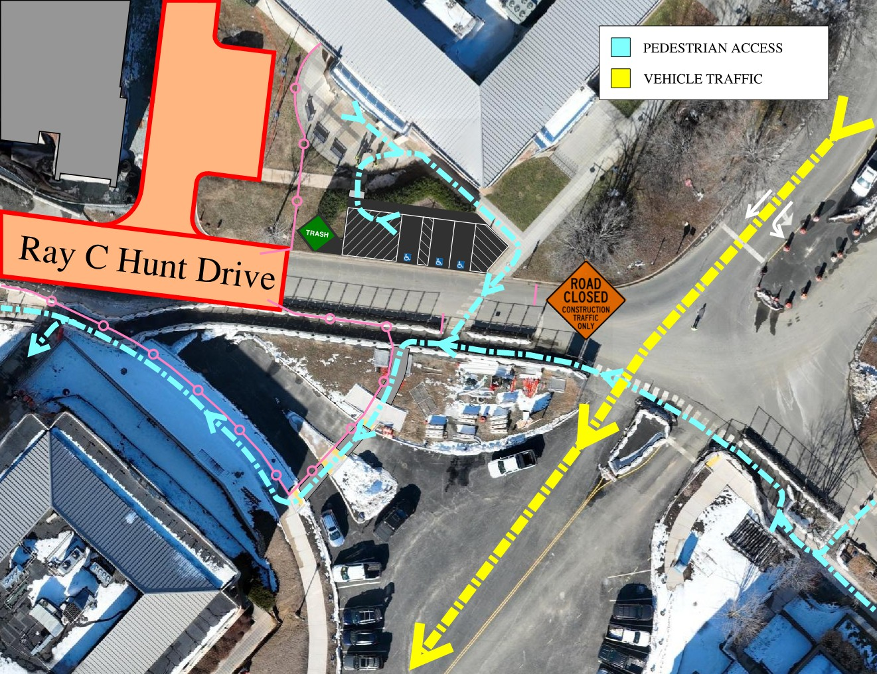

Slide 10
Ray C Hunt Road Closure – March 24th – mid-July 2025
Scope of work :
  Installation of utilities in RCH requiring deep excavations in the road
Impact:
  No right turn from Fontaine entrance allowed (service vehicles only)
  Alternate routing through spine road
  Rock will be encountered during utility installation and will require hoe-ramming creating intermittent noise and vibrations
  400 RCH loading dock will be closed during this time
  ADA parking and deliveries accommodated in front of 400 RCH
Notes:
Project Teams
Institute of Biotechnology Mashal Afredi-Hartman
Central Energy Plant John Marshall
Roadway Infrastructure Taryn Spence
Parking Garage Taryn Spence
Encompass Renovation Rachelle Hermes

Slide 11
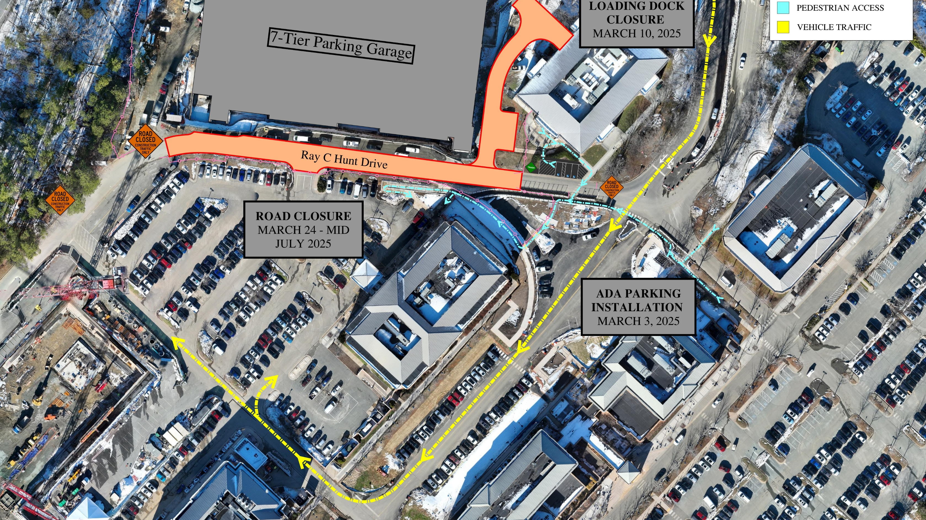

Slide 12
TRAFFIC & PEDESTRIAN IMPACTS
Sam Walker

Slide 13
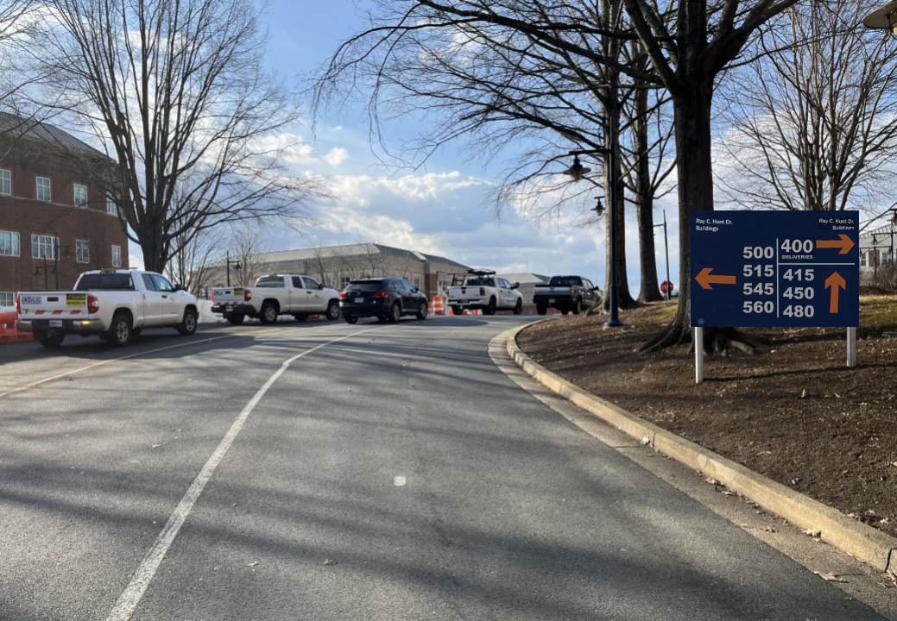
UVA Wayfinding Signage Entering Fontaine Research Park

Slide 14
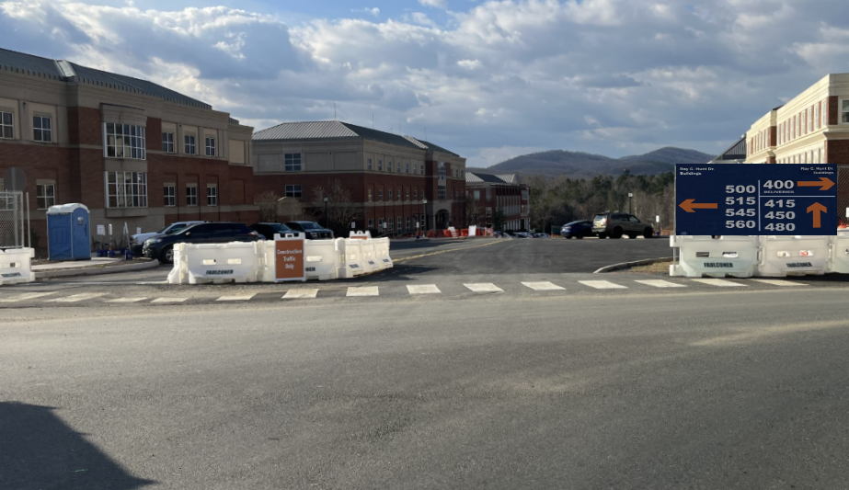
UVA Wayfinding Signage At The Fontaine Research Park Entrance Intersection

Slide 15
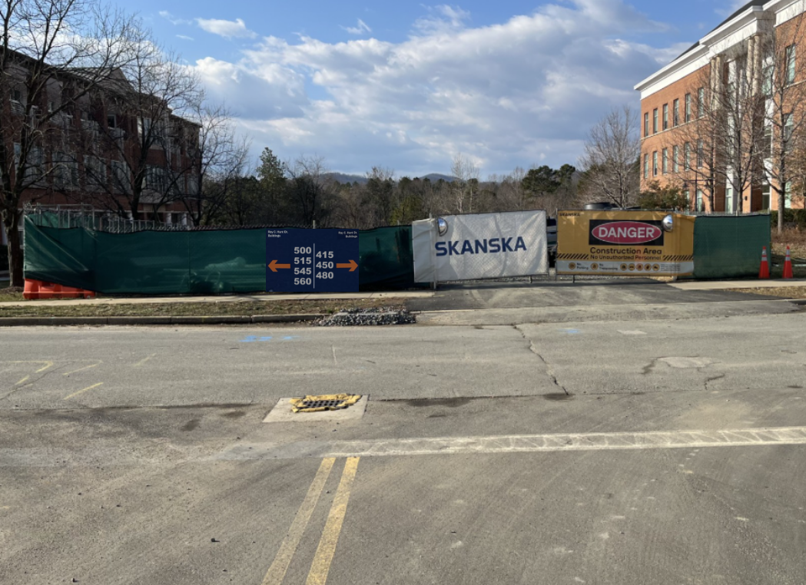
UVA Wayfinding Signage At The Spine Road Intersection

Slide 16
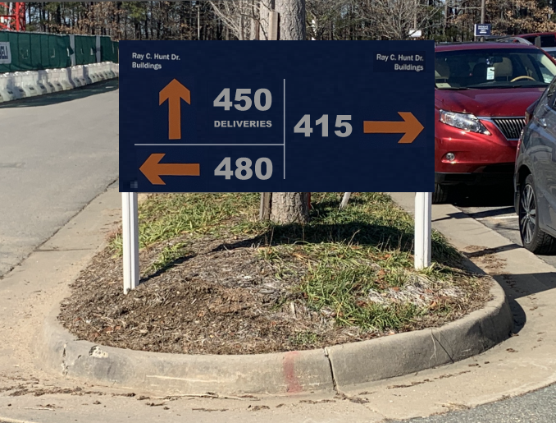
UVA Wayfinding Signage At 415, 450, & 480 RCH Buildings

Slide 17
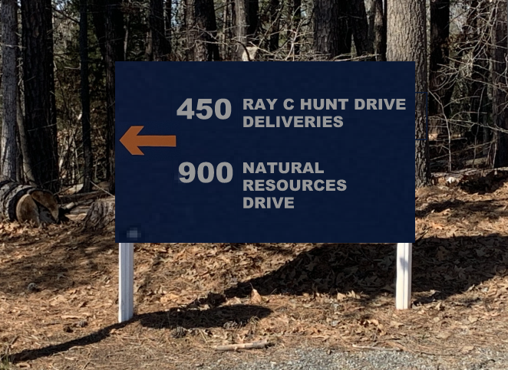
UVA Wayfinding Signage For 450 RCH Building Deliveries &
900 Natural Resources Drive Building

Slide 18
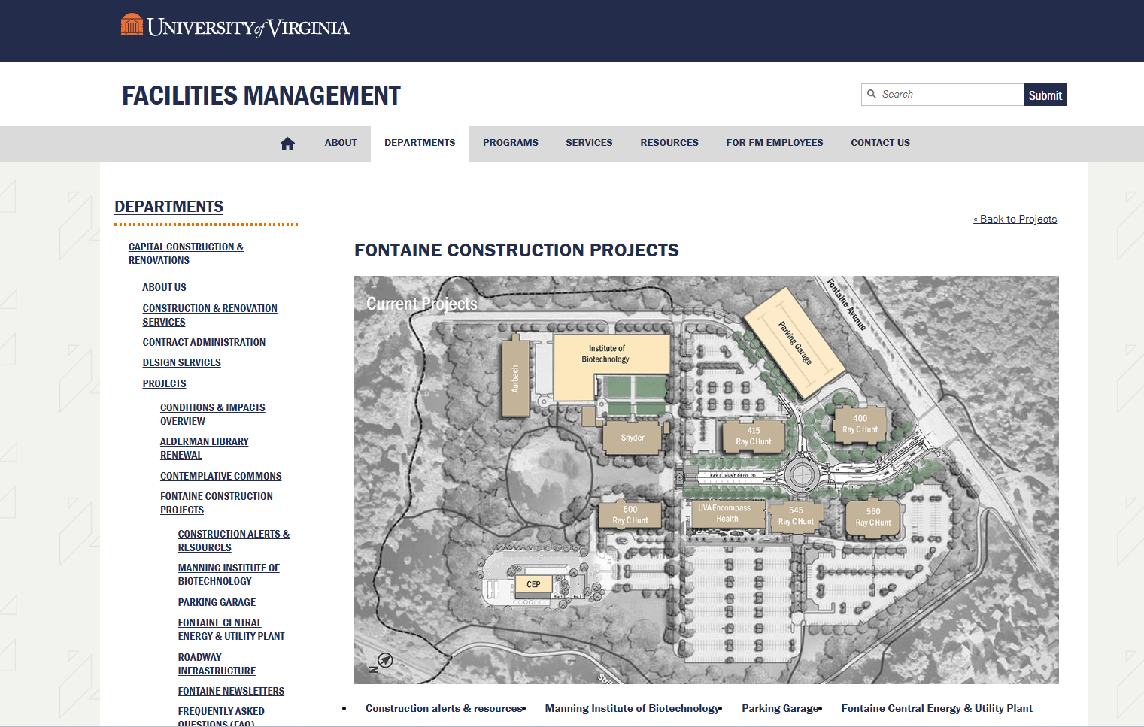
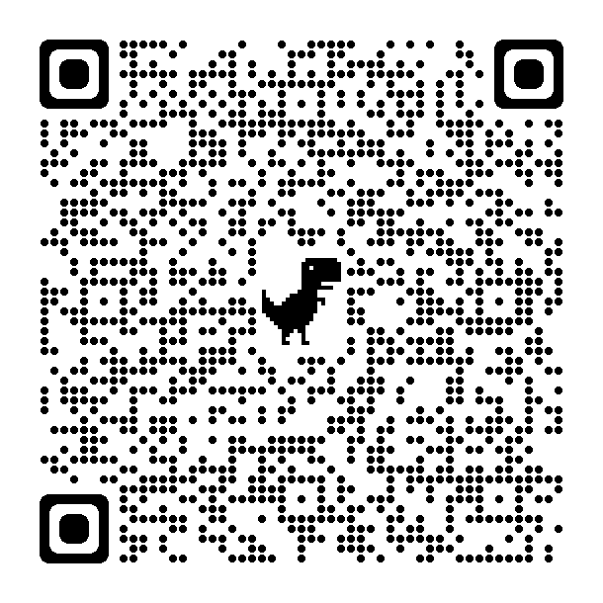
Project Information & Construction Alerts
Communication:
Website
FontaineConstruction@virginia.edu

Slide 19
Thank you for your continued support, patience, and flexibility as we work to deliver the new parking garage!
Sincerely,
The Fontaine Parking Garage Team
Q&A

