Slide 1
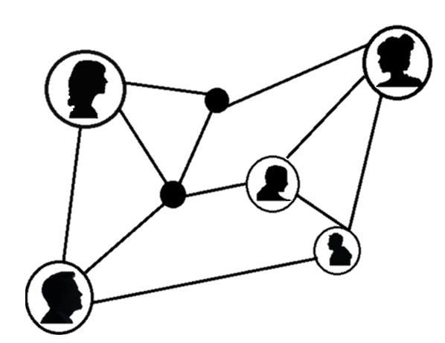
FM Leadership Connection: Progressive Discipline
February 22nd
AiM Overview and Hands-on Introduction
February 7th & 21st
Respect@ Workshop
February 15th
For more information or to sign up for Occupational Training sessions, please email
FM-Training@virginia.edu
Technology “How To”
Excel - Beginner
February 14th & 28th
ESL Conversational Coaching
February 5th, 12th, 19th, & 26th
Basics of Computing
February 1st, 8th, & 15th
AiM
Respect

