Slide 1
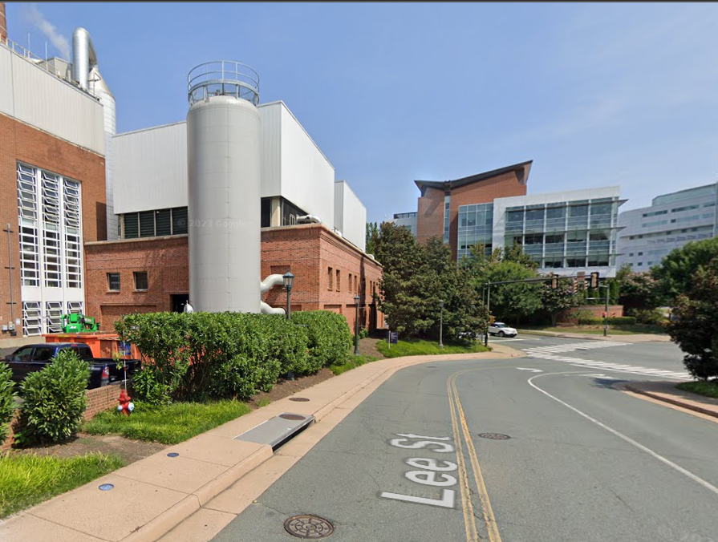
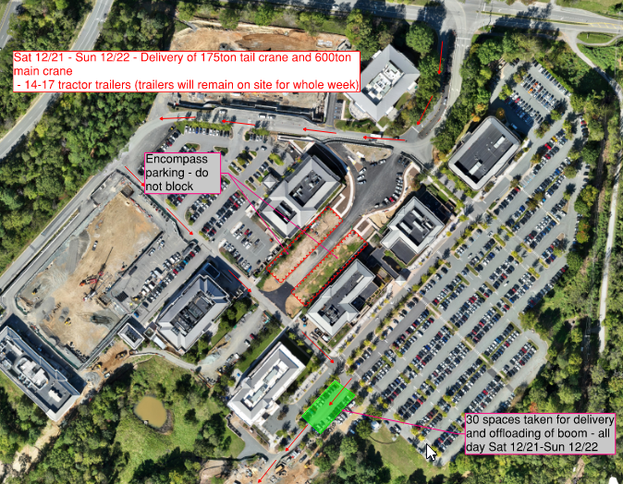
Hi Dave
I have two big deliveries that will impact pedestrians and traffic in the Fontaine park on Thursday 12/26 and Friday 12/27. I was hoping RMC might be able to provide some assistance for us with managing the pedestrians on those days. I think we would probably need three people. The activity will be intermittent on those two days, but we’ll probably need them here the whole day as the most impactful activity will most likely occur toward the beginning and the end of the day. Let me know if three staff members would be possible on those days, and I can then give you further details. It would also be meet out here in person in advance just to walk through the plan for those days.
Thanks

Slide 2
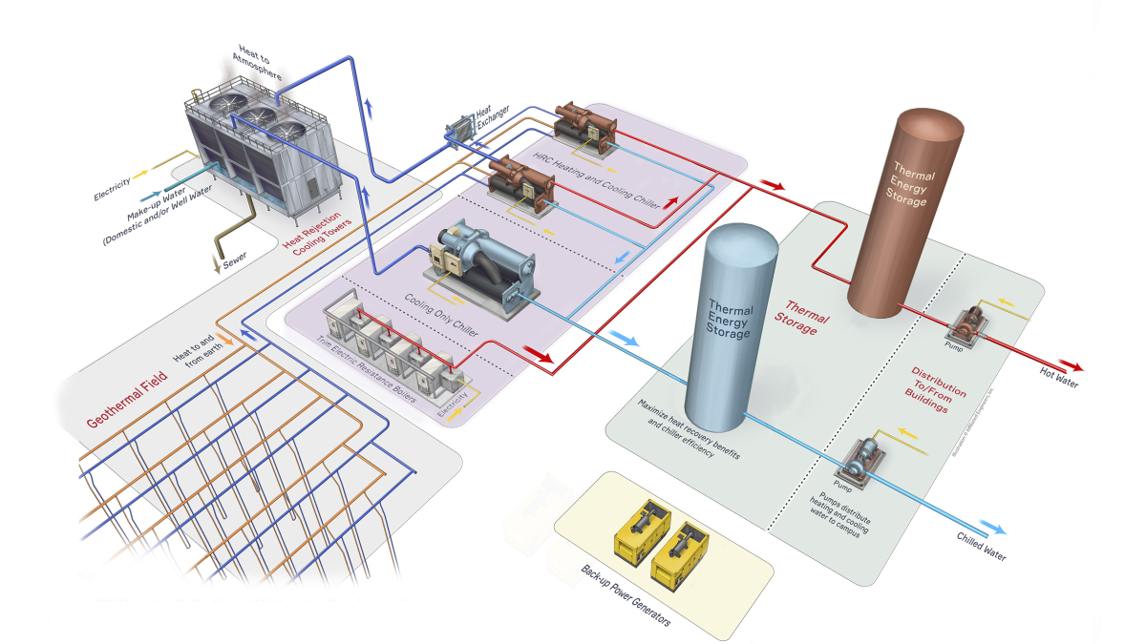

Slide 3
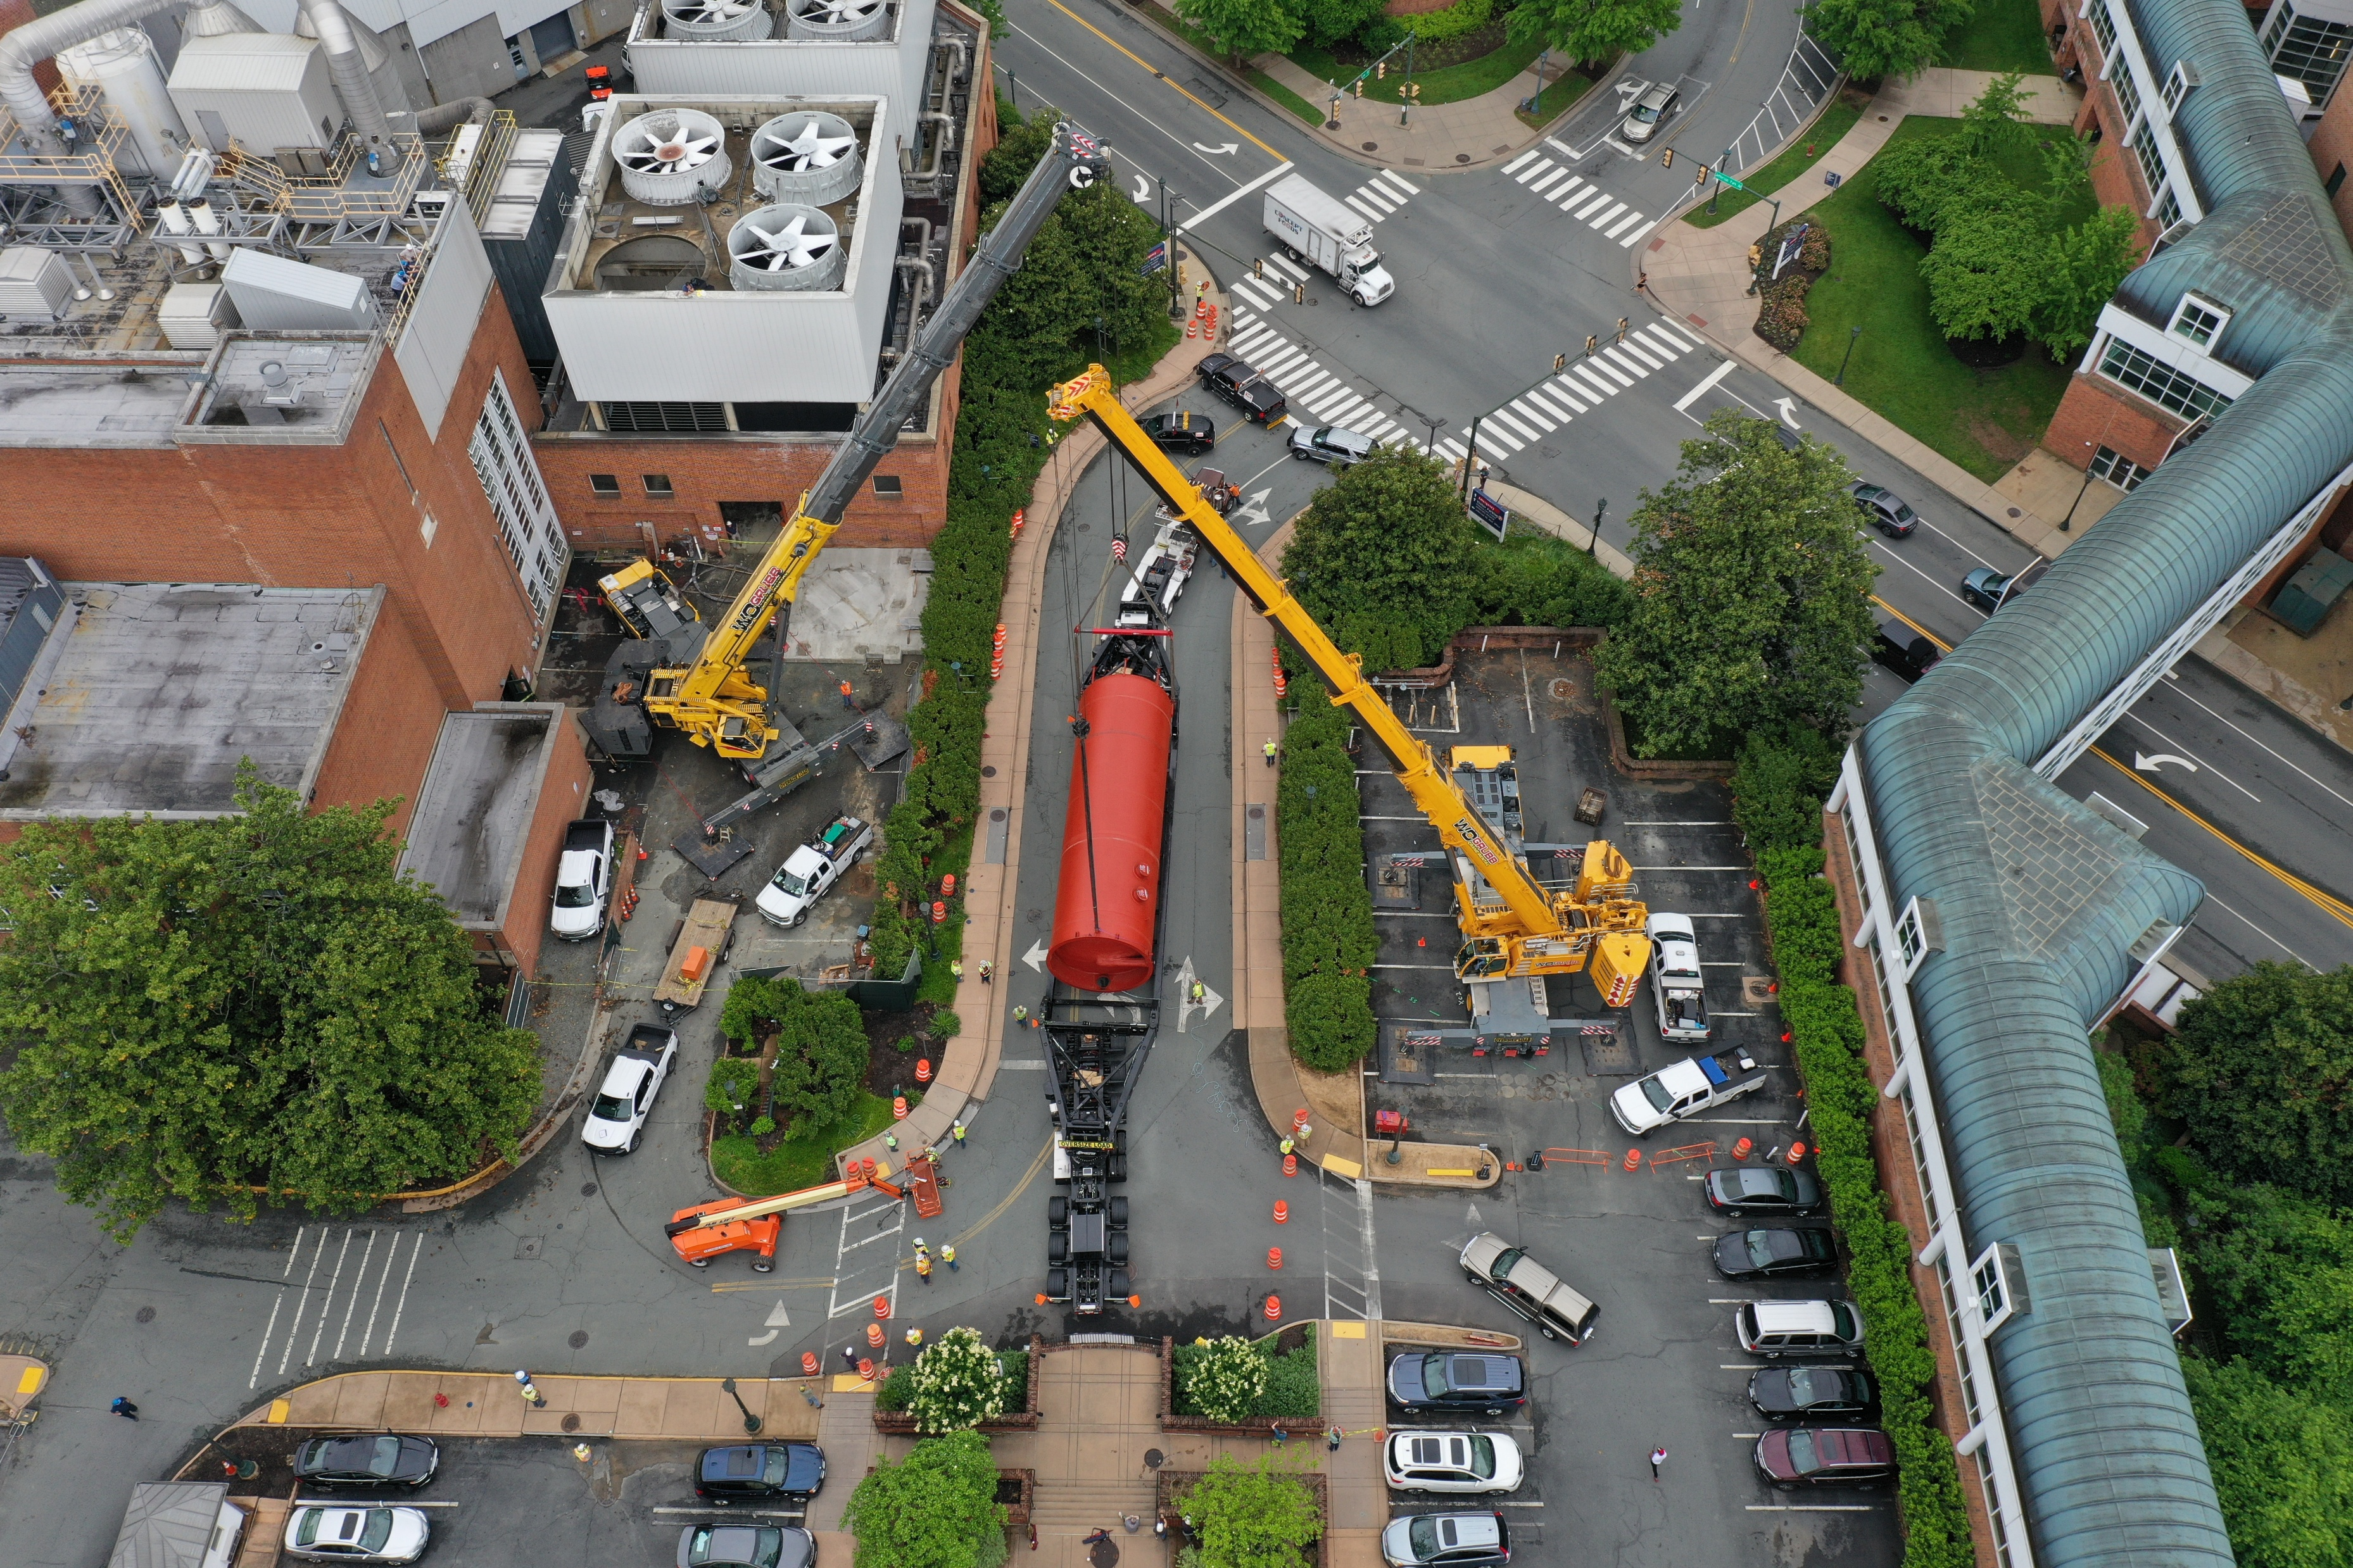

Slide 4
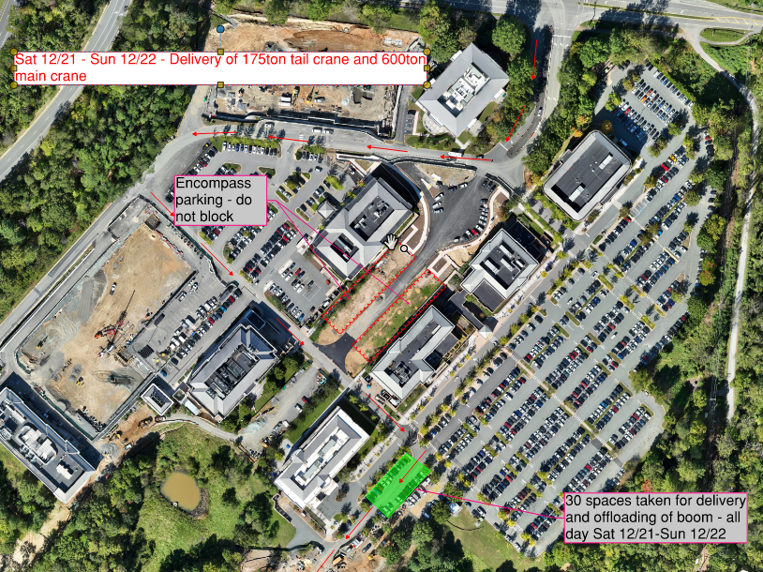

Slide 5
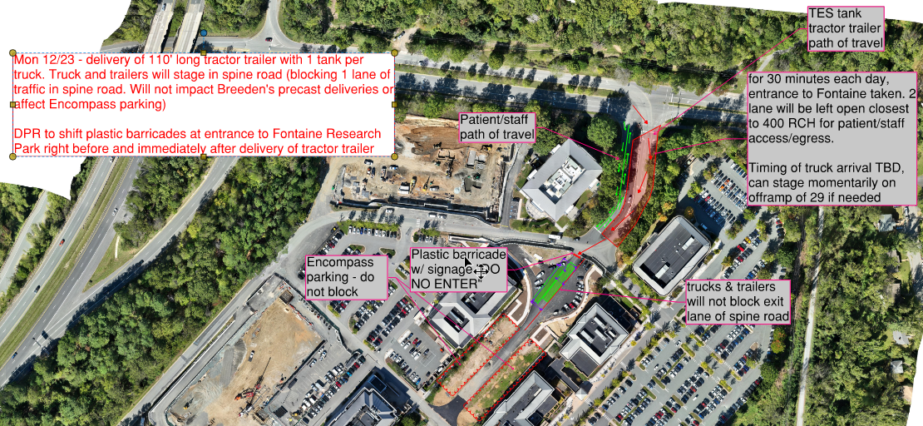

Slide 6
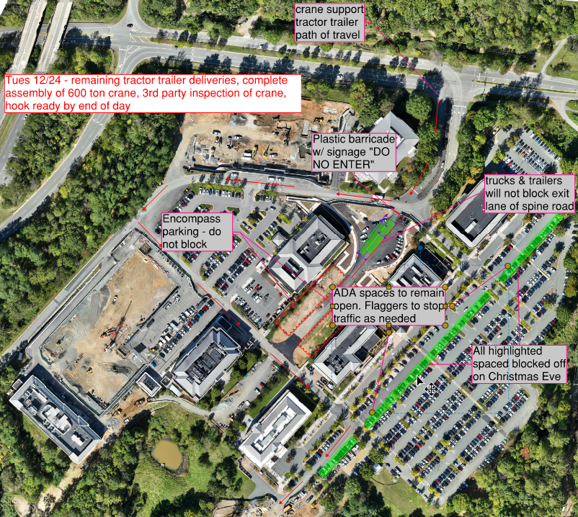

Slide 7
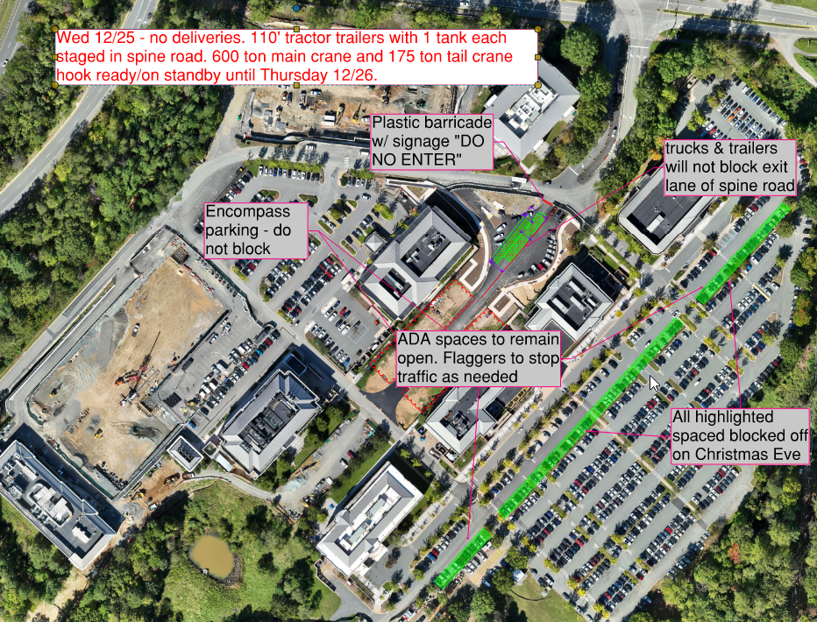

Slide 8
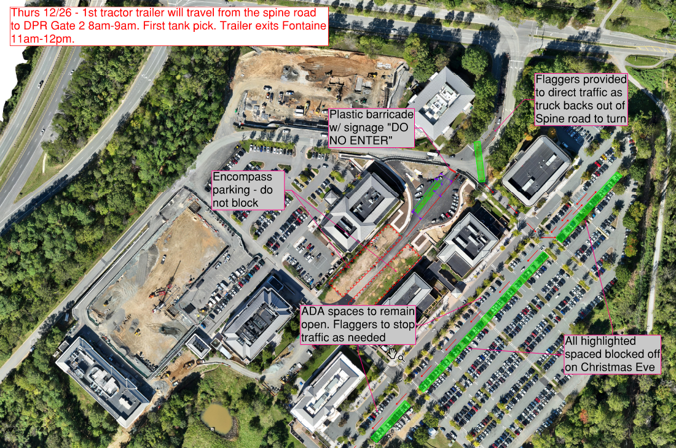

Slide 9
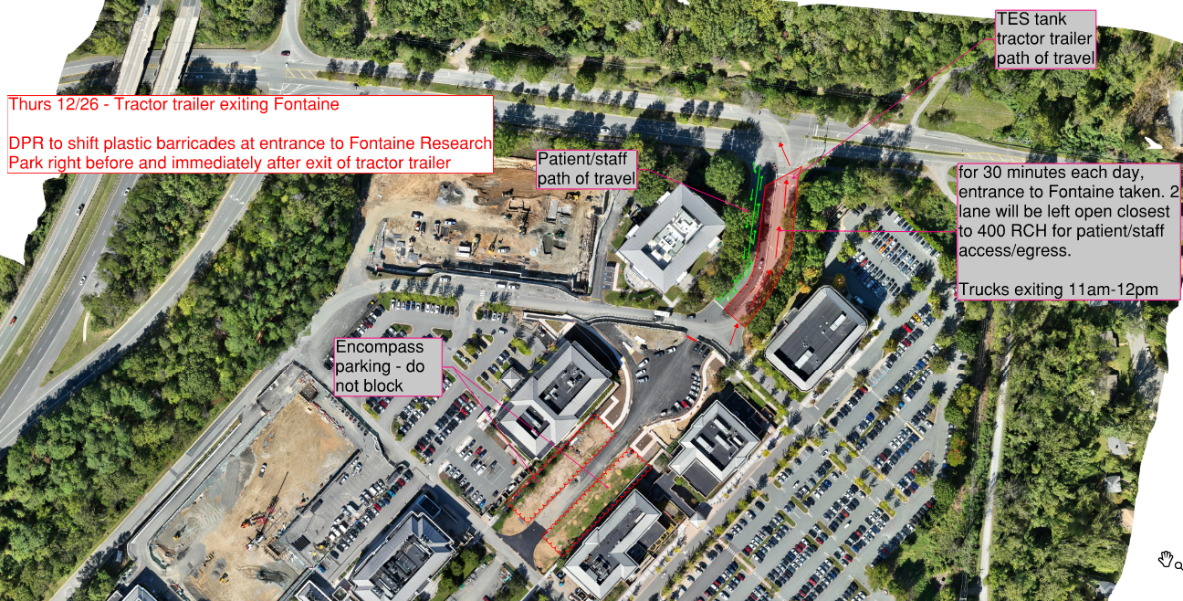

Slide 10
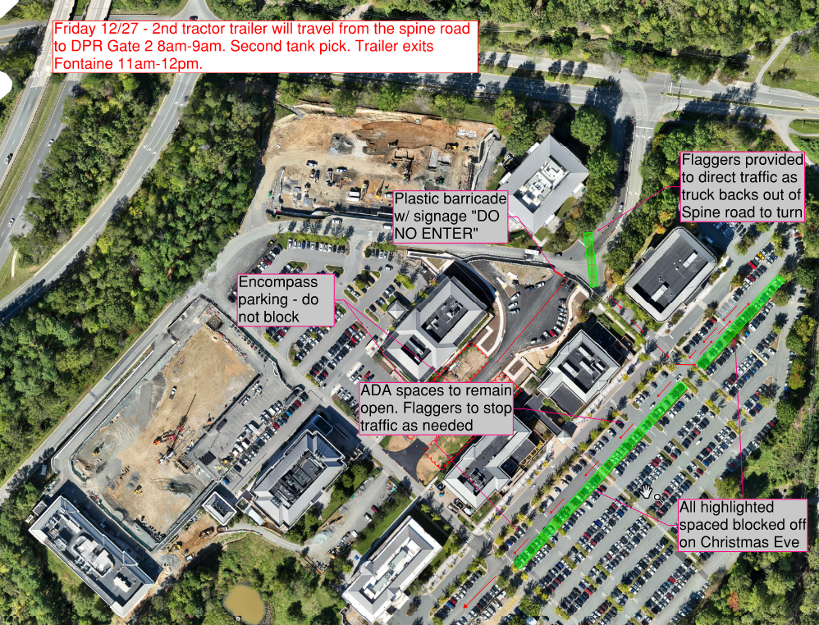

Slide 11
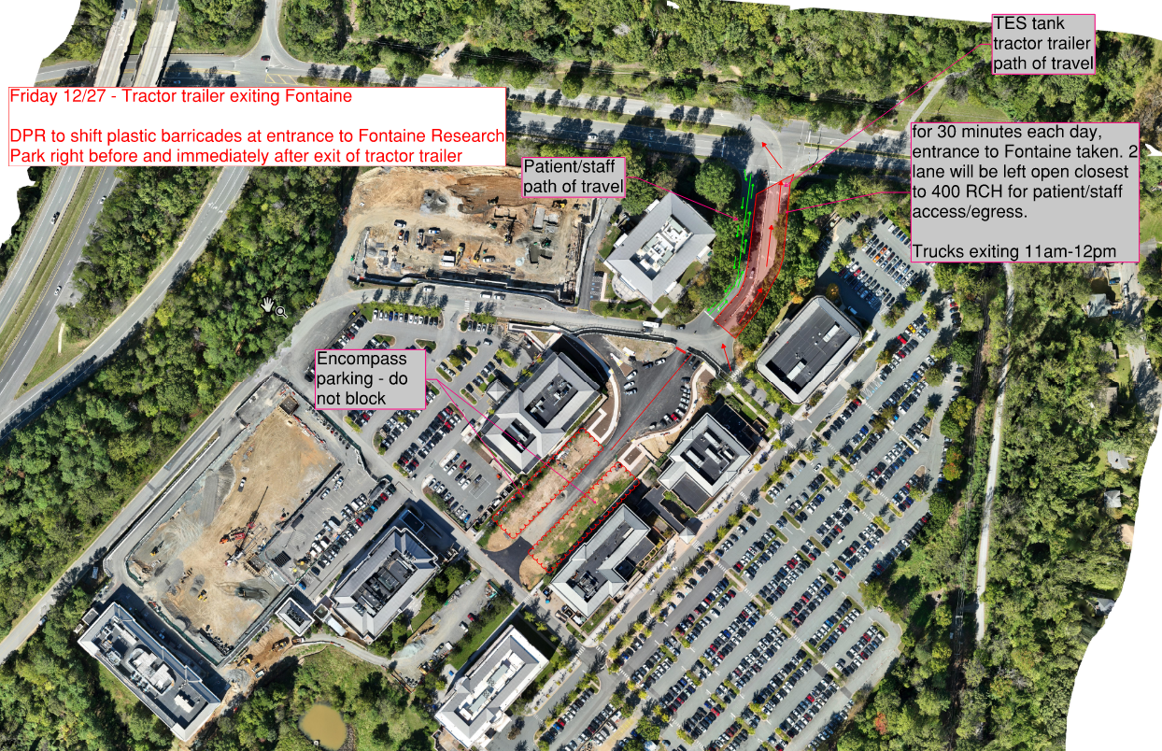

Slide 12
